Slide 1
Mapping the 7 layers of the IPv4 space

Slide 2
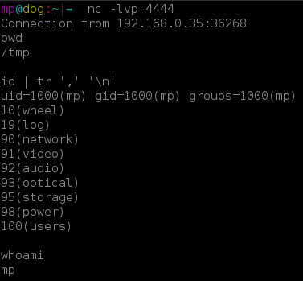

Slide 3
In the beginning….
>be me
>some gamer kid at fanshawe taking business
>cousin say to me “try gaming on linux”
>”what is linux?”
>install ubuntu 10.10
>read that I need to type “apt-get update”
>lol wut
>coolest shit I ever did see
>found backtrack5
>omg I want to be a hacker
>5 years later it’s a reality…. although I never did try to game on linux

Slide 4

How do internets even work

Slide 5

This is Not a networking lecture

Slide 6
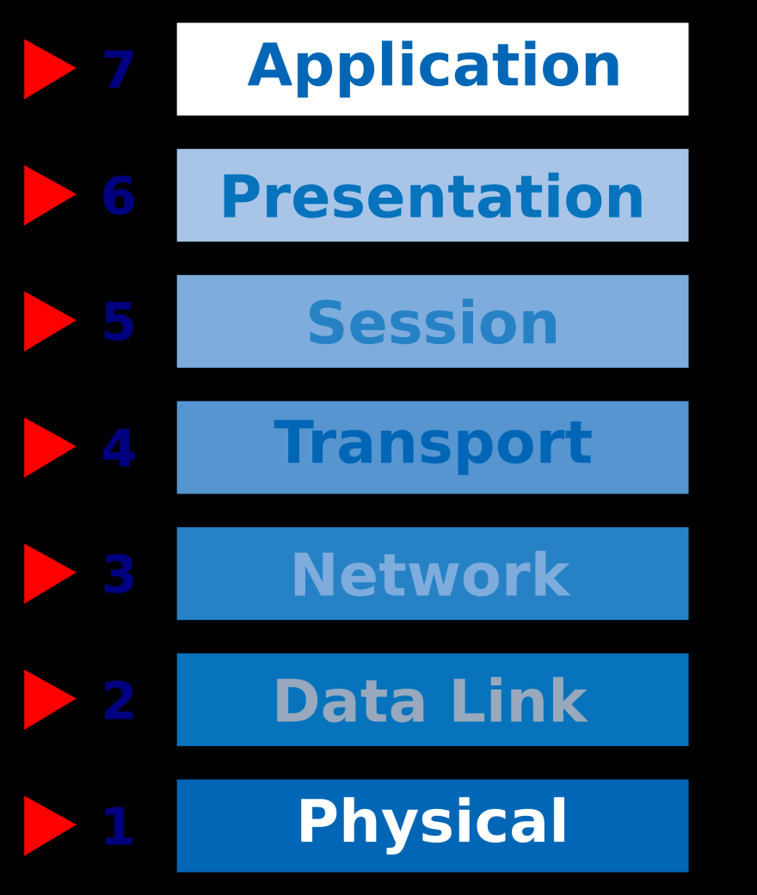
OSI model

Slide 7
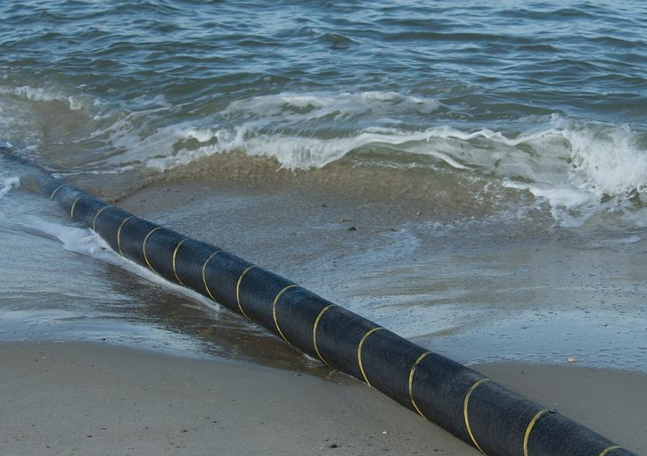
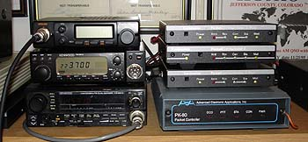
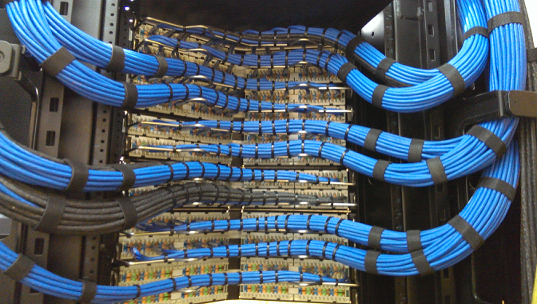
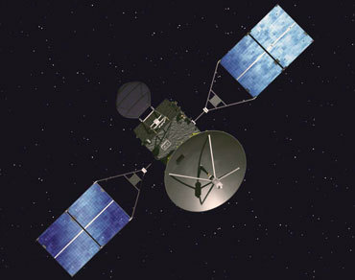
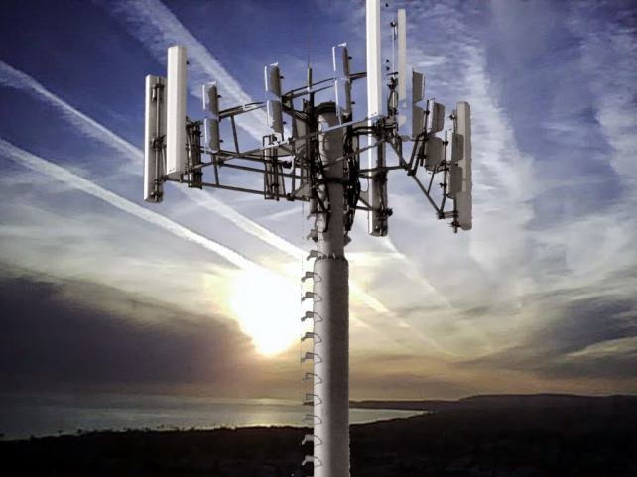
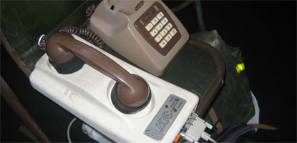
Our journey begins at layer 1

Slide 8
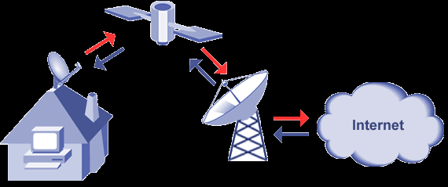
Satellites suck

Slide 9
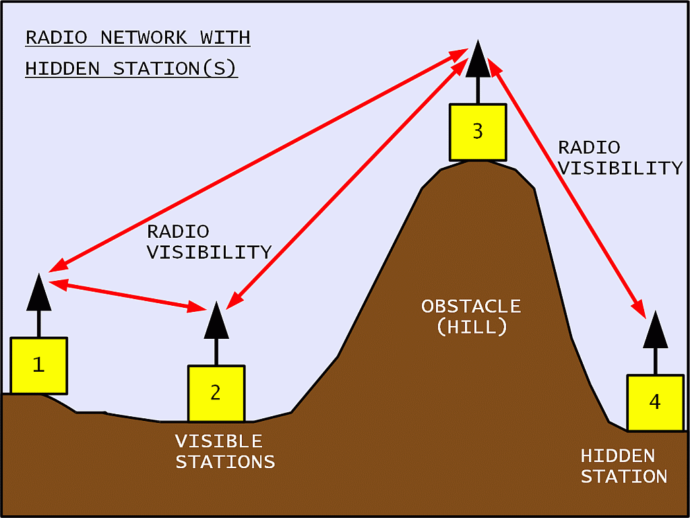
Yes packet radios are still around and yes they also suck (but they are fun)

Slide 10
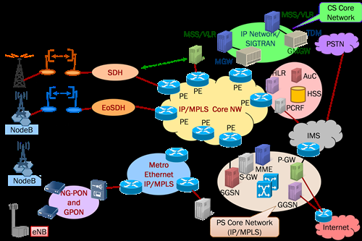
GSM/3g/LTE networks are okay…

Slide 11
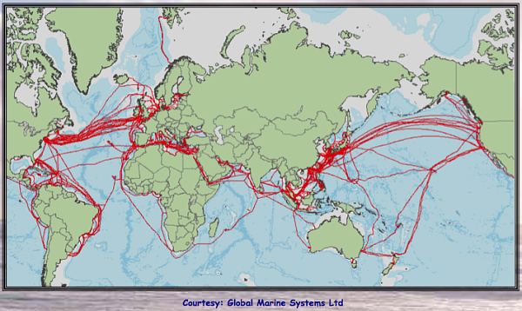
Can’t beat a wire

Slide 12
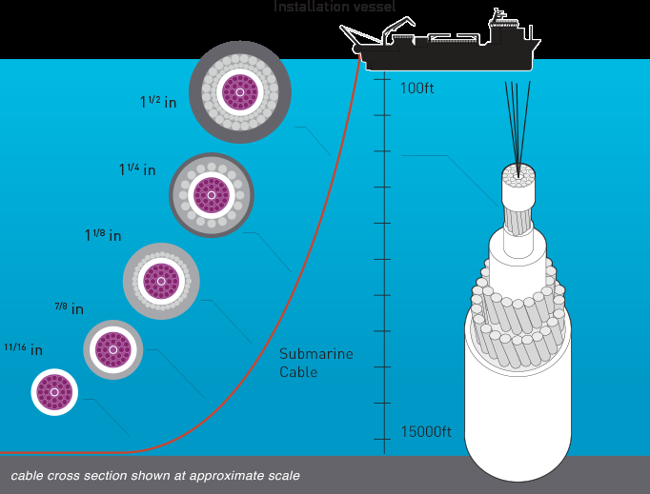
…And that’s how most of the world is connected

Slide 13
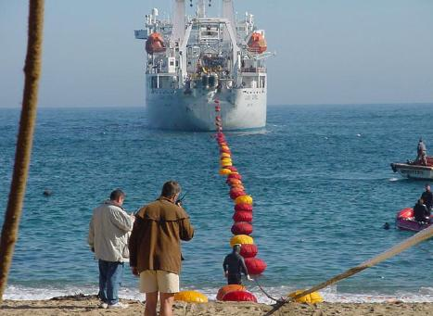
one of the coolest thing humans have done

Slide 14
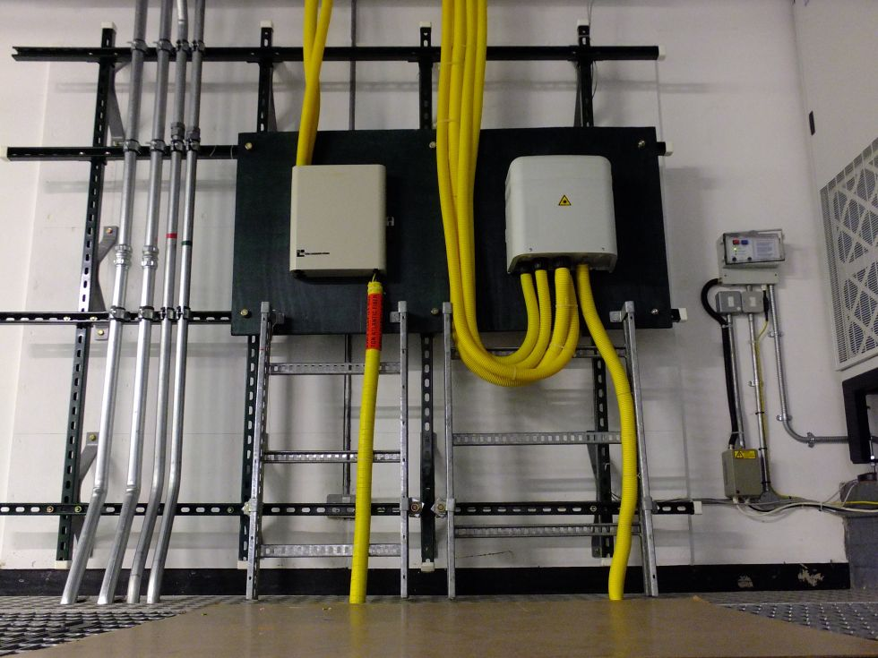
Cable termination points

Slide 15
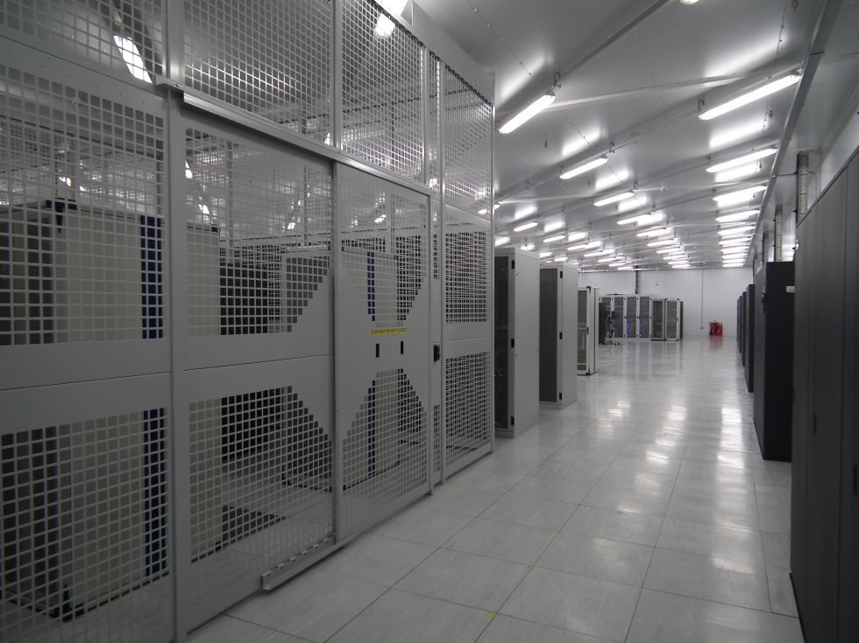
TIEr 1 Exchange points

Slide 16
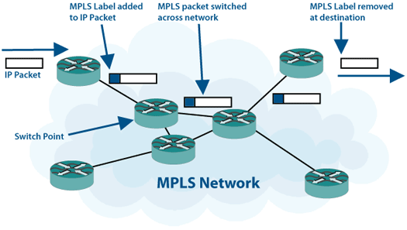
A Quick note about MPLS

Slide 17
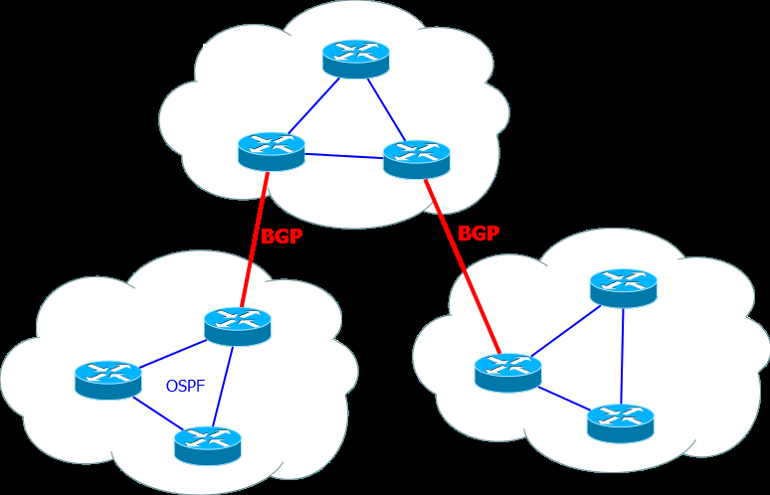
bgp

Slide 18

A bit of history before we continue

Slide 19

Arpanet
> 1963
> Some dude named J.C.R. Licklider predicts the internet
> Dubbed it “intergalactic computer network”
“the main and essential medium of information interaction for governments, institutions, corporations and individuals” “a place where everyone including your mother can shitpost dank memes”

Slide 20
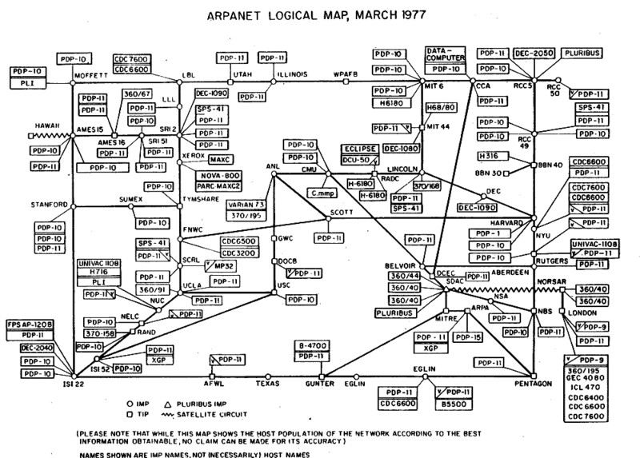
Arpanet topology

Slide 21

Darpa birthed IANA

Slide 22
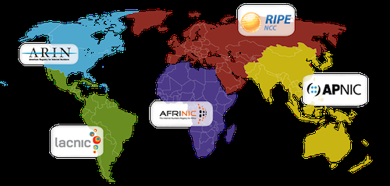
INTERNET NUMBER AUTHORITIES

Slide 23
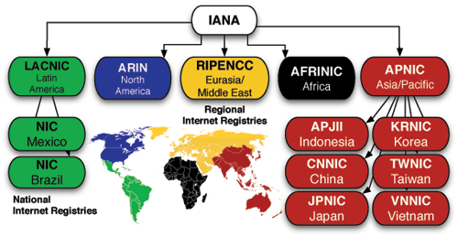
IANA RIR

Slide 24
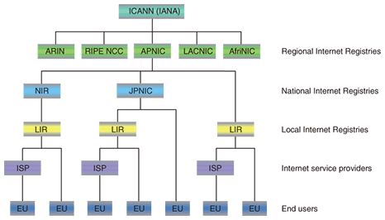
IPV4 Address distribution

Slide 25
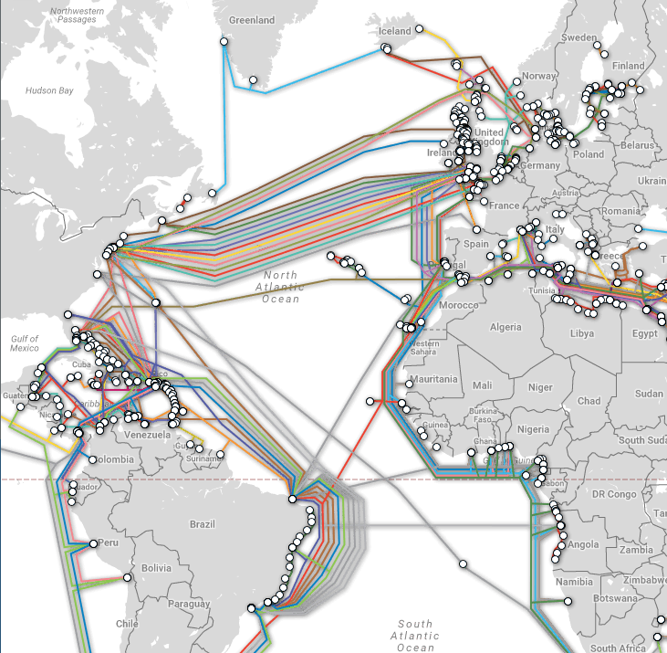
Quick recap

Slide 26

Back to BGP
> ISP’s are assigned ASN by RIR/LIR
> With an ASN you can apply for a block of IPv4 addresses
> Peering agreements are negotiated
> Peers advertise routes to each other known as prefix

Slide 27
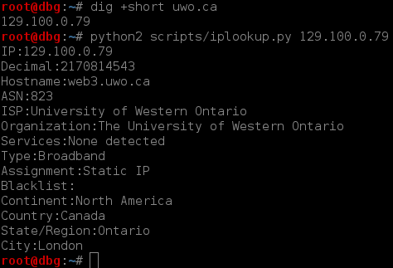
Enumerating an ISP Asn

Slide 28
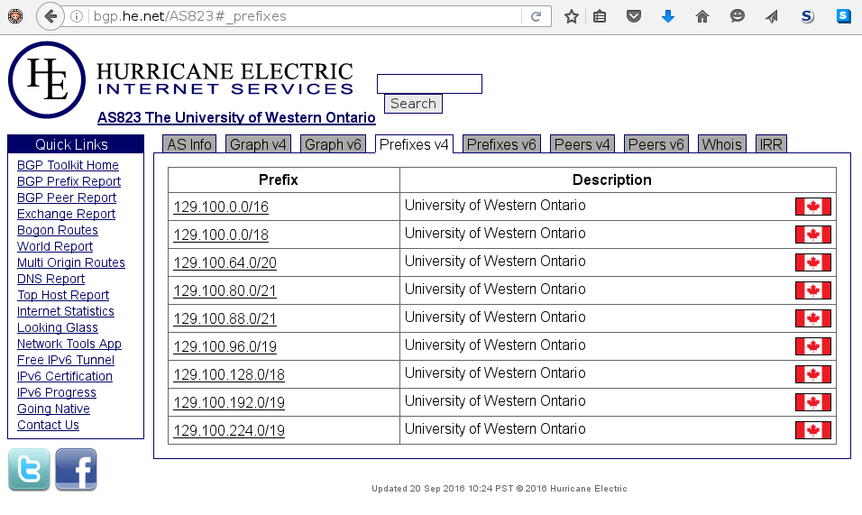
Enumerating advertisements

Slide 29
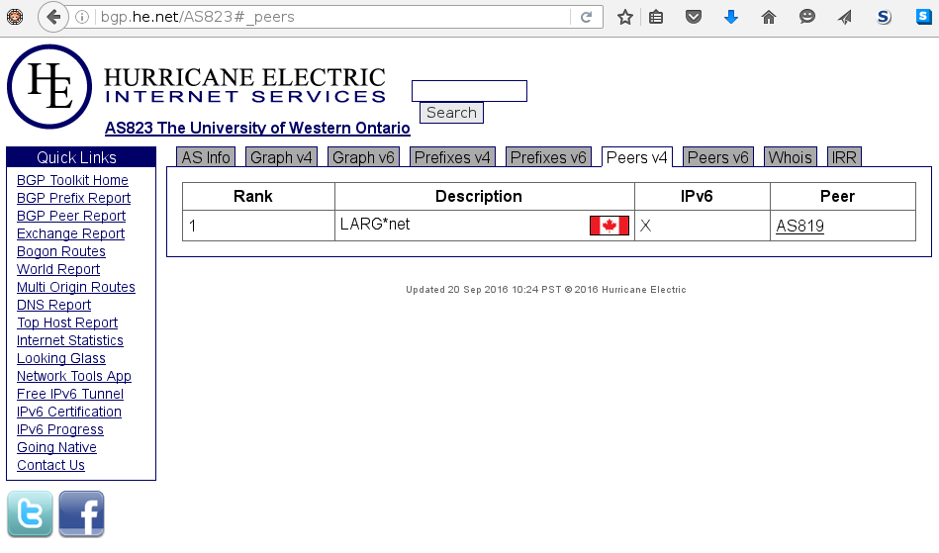
Move up the hierarchy

Slide 30
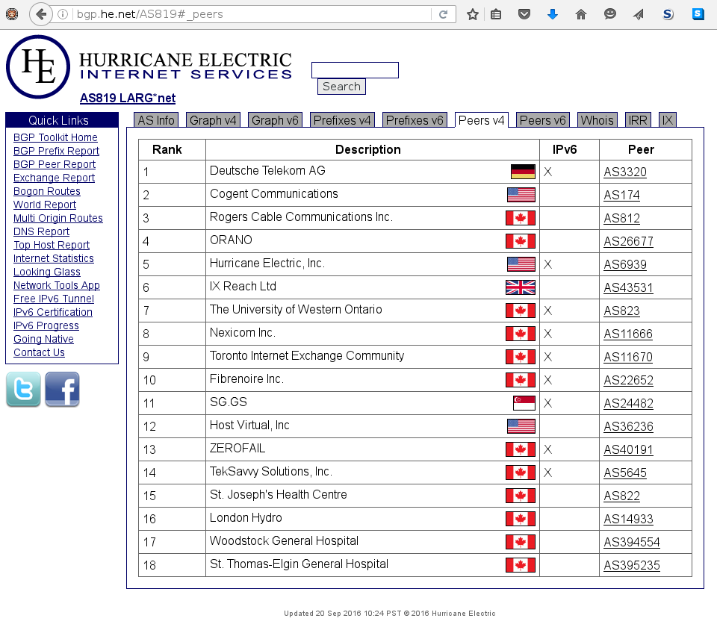
Keep going…

Slide 31
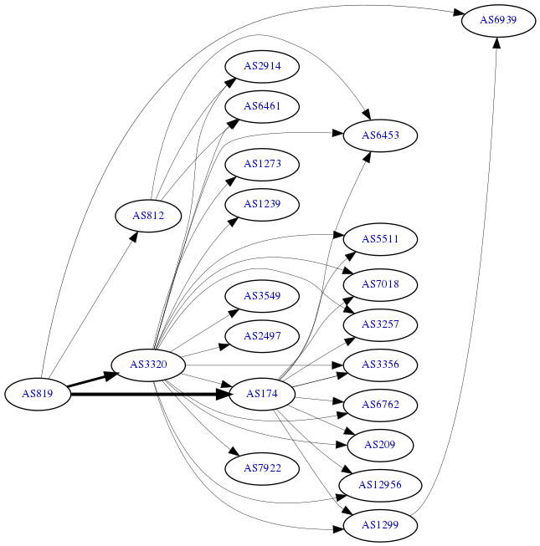
propagation

Slide 32
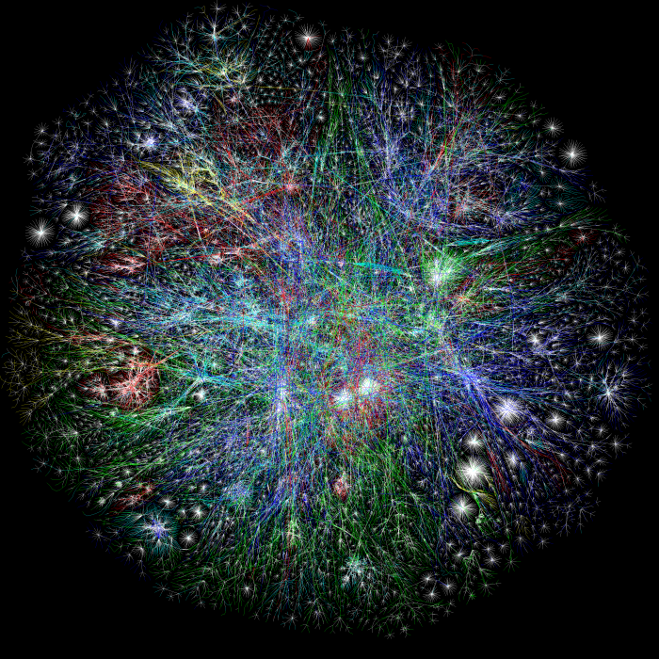
What the internet looks like

Slide 33

Attacking the internet (BGP)
> Prefix Hijacking
> Sniffing route leaks
> Poisoning route caches
> MITM Routes ( route snooping )
> Layer 4 injection attacks
> Possibility to take over continents
> Hack all the things

Slide 34
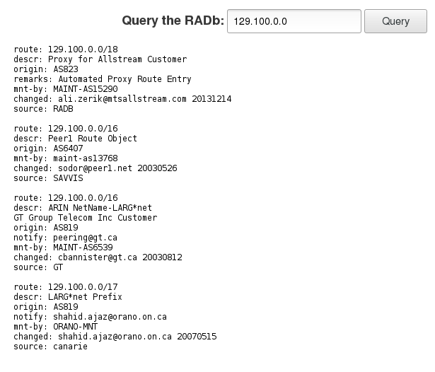
Investigating internet route registries

Slide 35

Abusing internet route registries
> IRR injection
> Poorly maintained
> Distributed ( no goto list )
> Sign up and just make content
> Easily hijack a BGP prefix

Slide 36
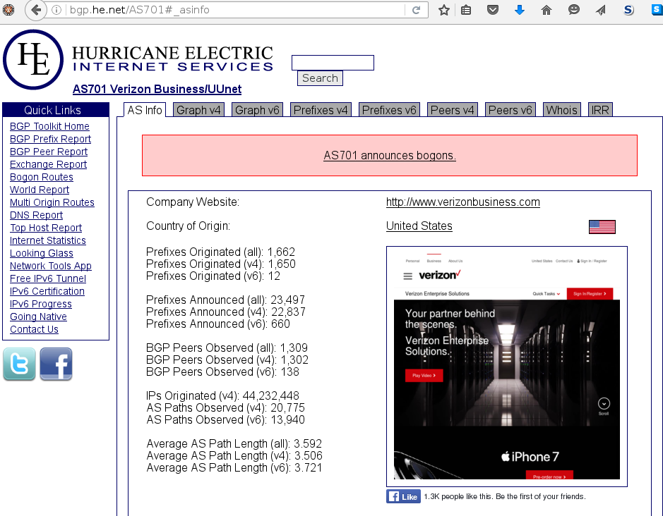
bogons

Slide 37
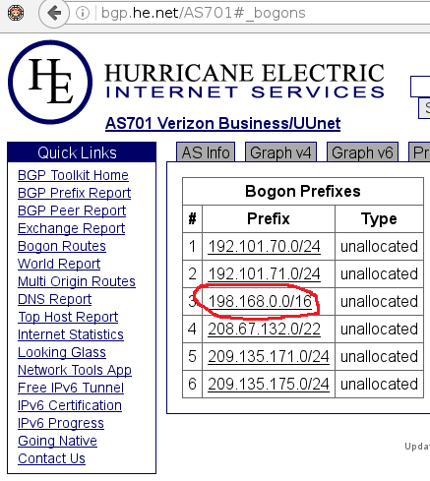
Internal blocks? Seriously?

Slide 38

Internet cartography

Slide 39
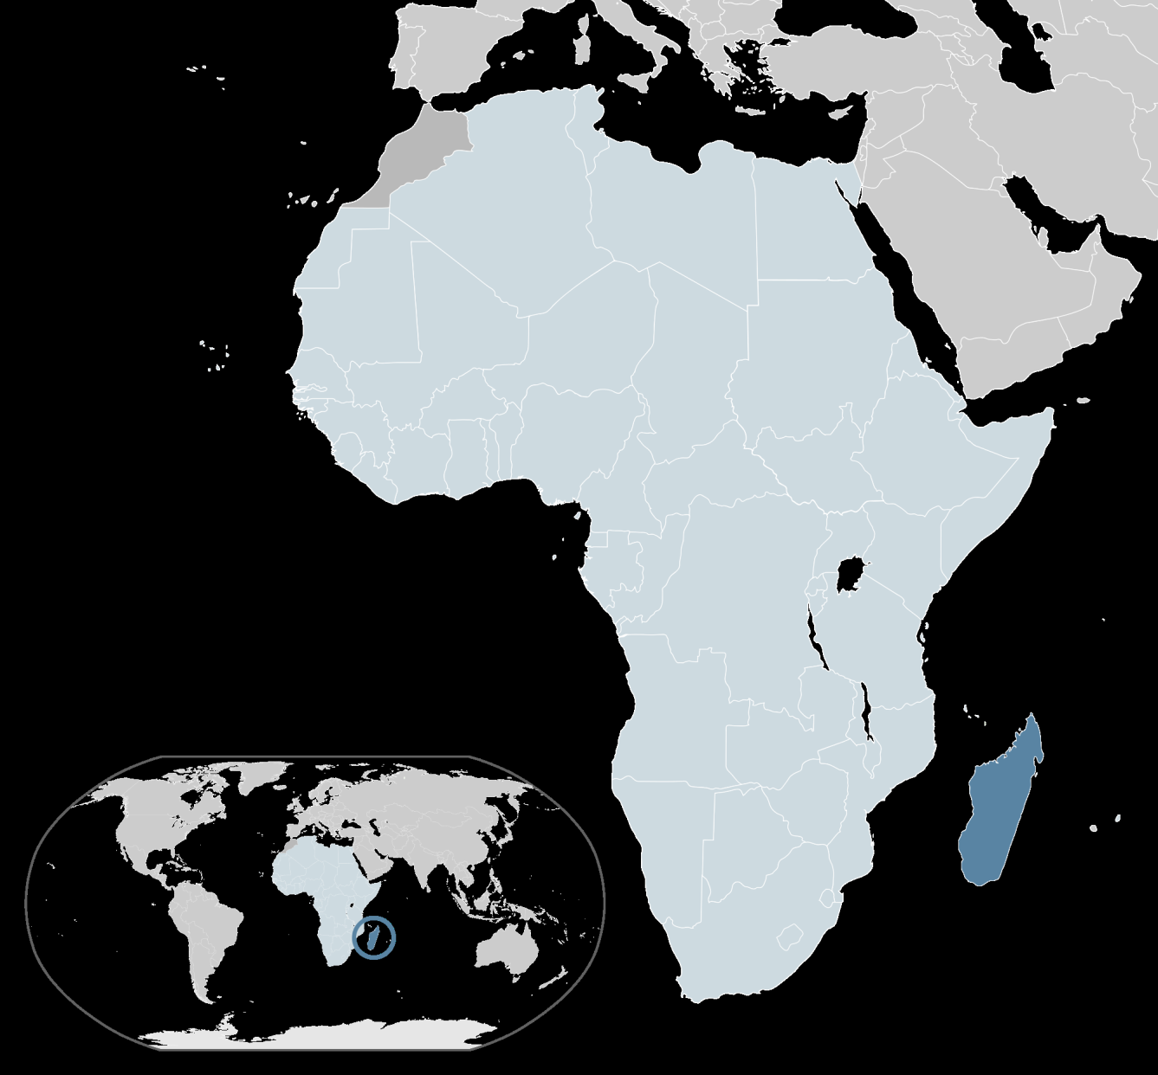
Mapping Madagascar
> What ISPs can we find that are active on Madagascar?
> Who are their peers ?

Slide 40
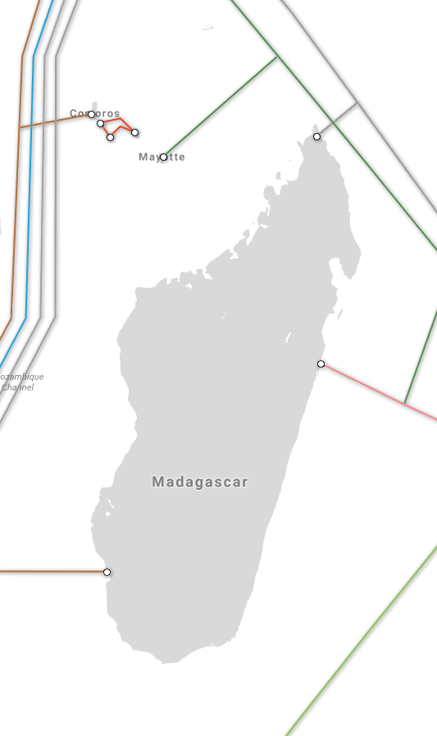
Start with layer 1

Slide 41
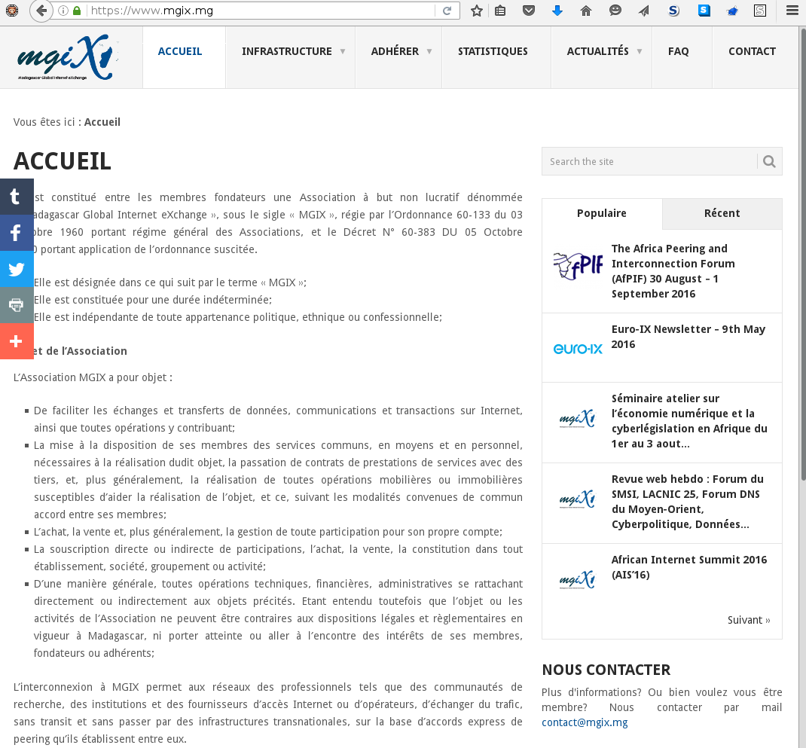
Exchange point enumeration

Slide 42
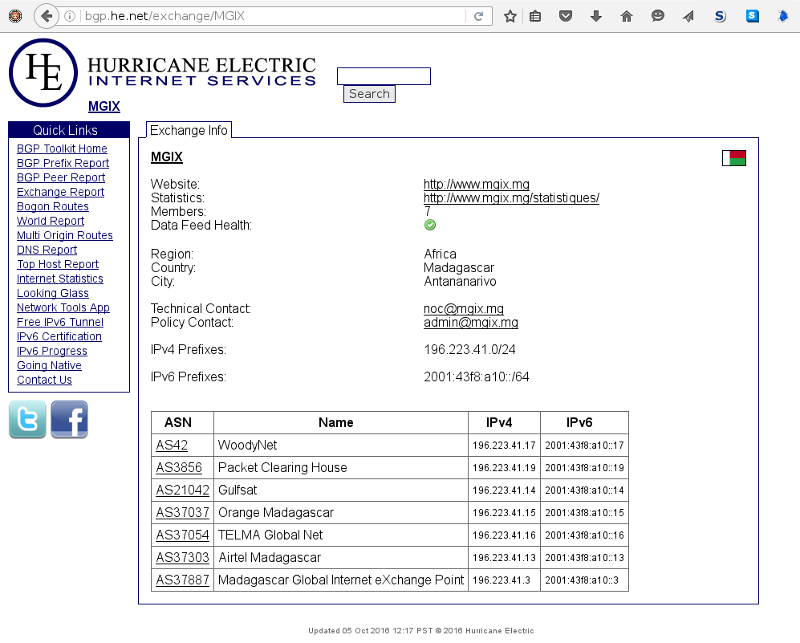
Now work your way down to the ISP

Slide 43
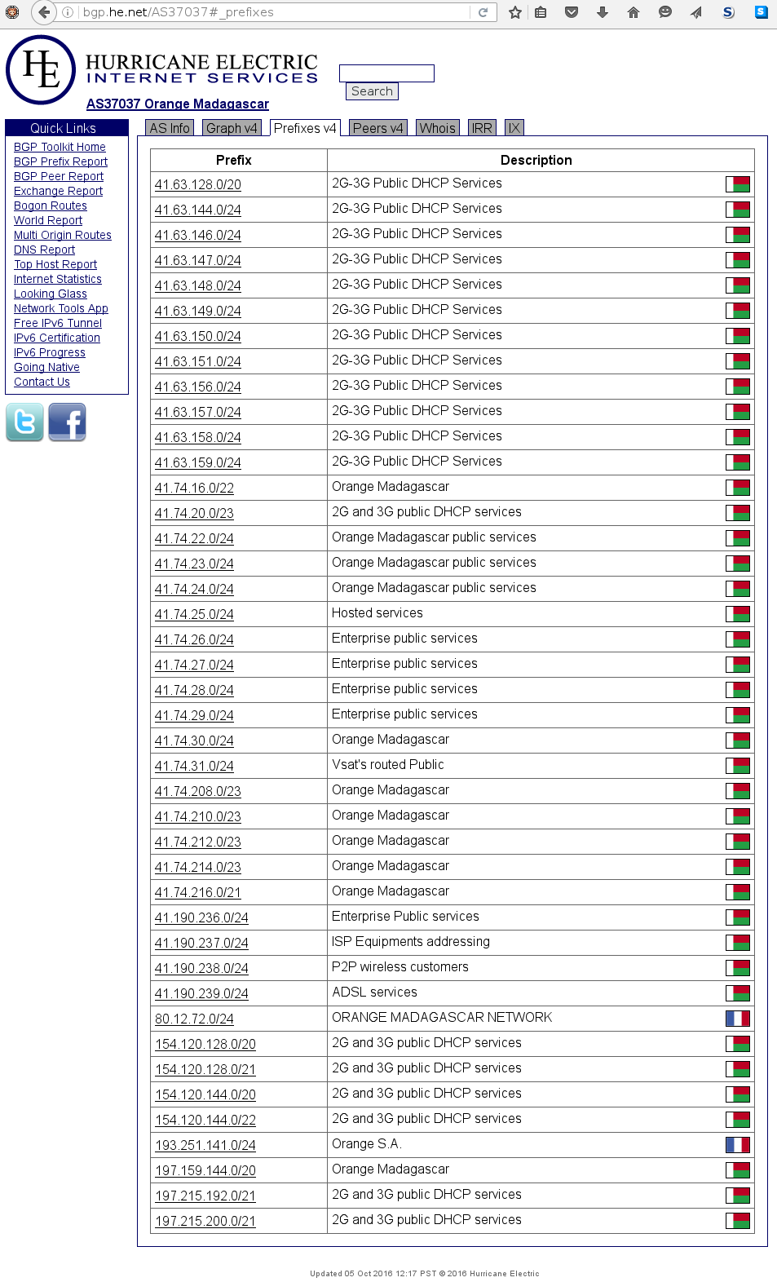
… and scrape their prefixes

Slide 44

now what??
> Search for buried treasure
> Find answers to questions
> Conduct research and experiments
> Brag about your findings on some blog for 1337 points
> Be ethical but stay grey

Slide 45

Masscan setup
> git clone https://github.com/robertdavidgraham/masscan
> cd masscan && make –j
> iptables –A INPUT –p tcp --dport 666 –j DROP
> ln –s /path/to/masscan/bin/masscan /usr/sbin/masscan

Slide 46
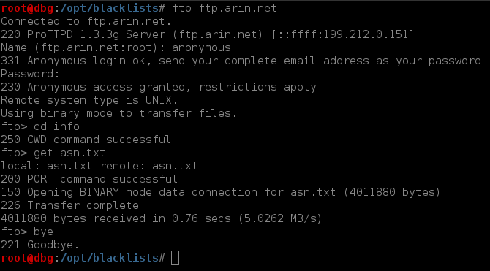
Public lists

Slide 47
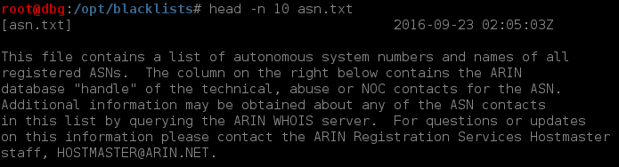
Public lists

Slide 48
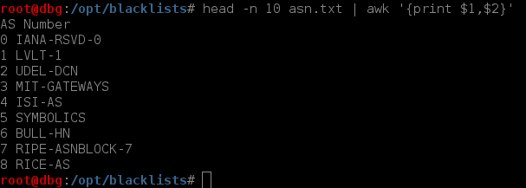
Public lists

Slide 49
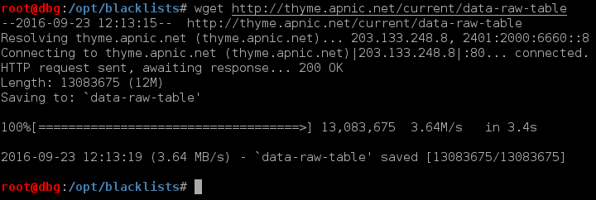
Public lists

Slide 50
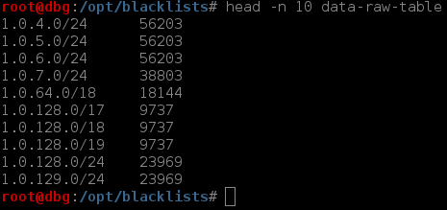
Public lists

Slide 51
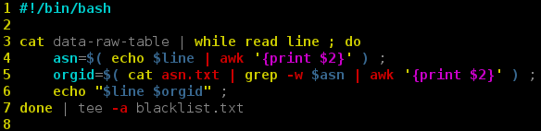
Data correlation

Slide 52
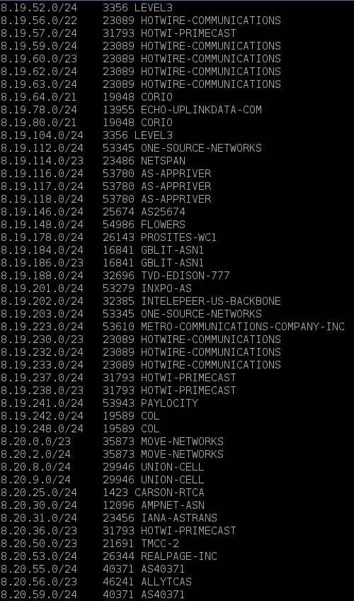
Data correlation

Slide 53
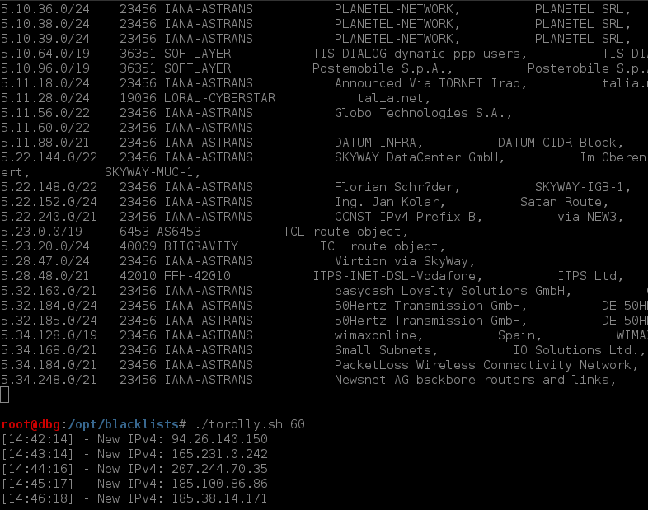
Whois’ing the entire internet

Slide 54
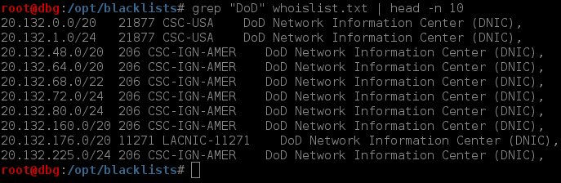
Analyzing the global whois

Slide 55
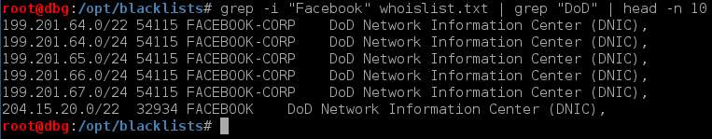

Find Weird (Questionable) relationships

Slide 56
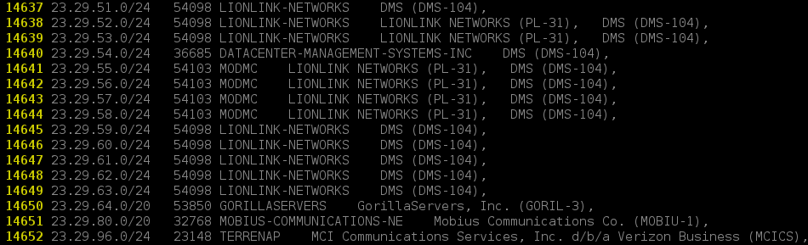
Create a blacklist/whitelist
Lazy/Risky way:
grep –Ev ‘keyword|keyword|keyword|keyword….’
Tedious/Safer way:
vim globalwhois.txt

Slide 57
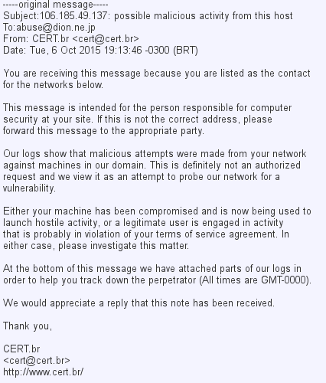
Benefits to tedious approach

Slide 58
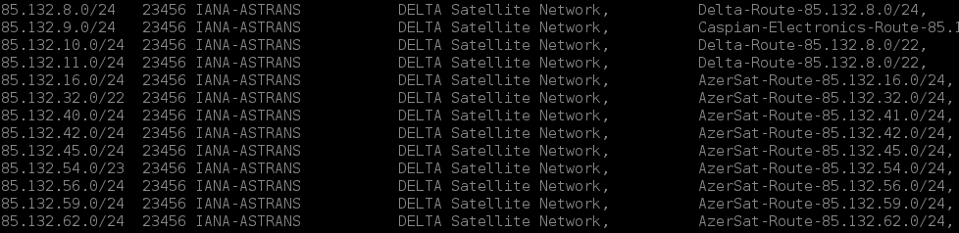


Find/investigate cool ranges

Slide 59

Launching the scan
With whitelist:
./masscan –p 21 –banners –source-port 666 -oG scan.txt -iL targets.txt
With blacklist:
./masscan –p 21 --banners --source-port 666 –oG scan.txt --excludefile bl.txt

Slide 60

Mapping the global irc space

Slide 61


Pro tips: know the protocol

Slide 62

Interpreting raw scan data

Slide 63


Cleaning and enriching data

Slide 64

Hunting botnets

Slide 65

What is buttnet

Slide 66

perl bots

Slide 67

DDOS Attacks

Slide 68

Auto ‘sploiting

Slide 69

Perl bots

Slide 70

Perl bots cont.

Slide 71

Xdcc botnets

Slide 72

Xdcc bots

Slide 73

XDCC bots

Slide 74

Networks in your backyard

Slide 75


Pinpoint the city

Slide 76

roll up and be like

Slide 77

Have a bit a fun

